Slide 1


Hospital management system data analysis
By dr doaa hussein

Slide 2

OUR HOSPITAL DATA
Hospitals are the most important part of our lives, trying to provide the best medical facilities to people suffering from various type of illness, which may be due to change in climate conditions, increased work-load, emotional trauma stress etc. It is very much difficult for the hospital to maintain its day-to-day activities and records manually. That is why a database is required to keep records of all type of activities of a hospital.
By storing information in a relational database, all the tasks relate to daily functioning of the hospital can be performed easily and much more efficiently. Hospital Database Management System (DBMS) is a comprehensive SQL project designed to streamline and optimize the management of hospital operations. This project aims to provide an efficient and user-friendly solution for storing, retrieving, and manipulating various types of healthcare-related data.
This database contains 7 tables:
Physician
Affiliated with
Department
Nurse
Patient
Patient Diagnosis
Procedures

Slide 3

Our goals is to answer this questions
is there a common disease between them with more 5 times primary check?
Doss hypertension more common in? males or females
What is the drugs that used in multiple conditions ?

Slide 4


Compare the primary check registration among positions ?
Positions occupied by more than one physician ?
Explore different diagnosis between males and females ?
Top 10 most expensive medical procedures ?

Slide 5
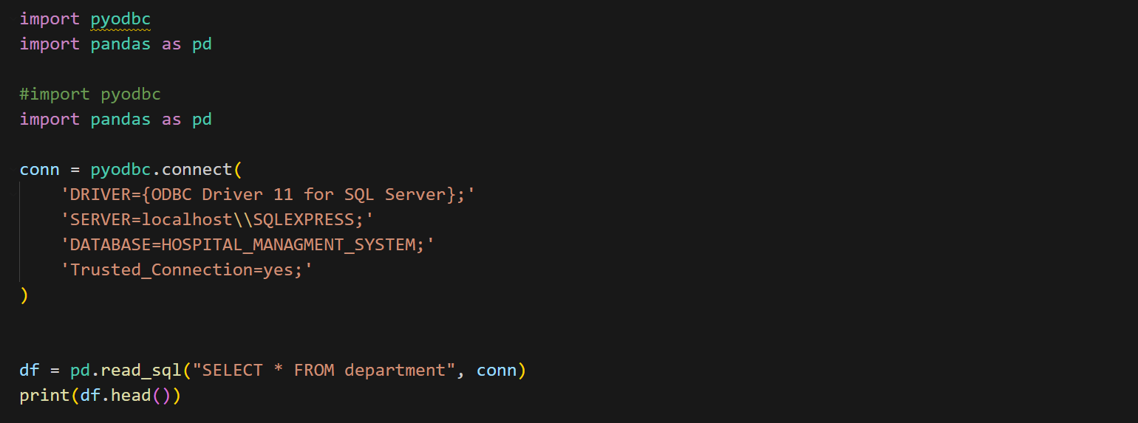
Sql connection with vs code

Slide 6
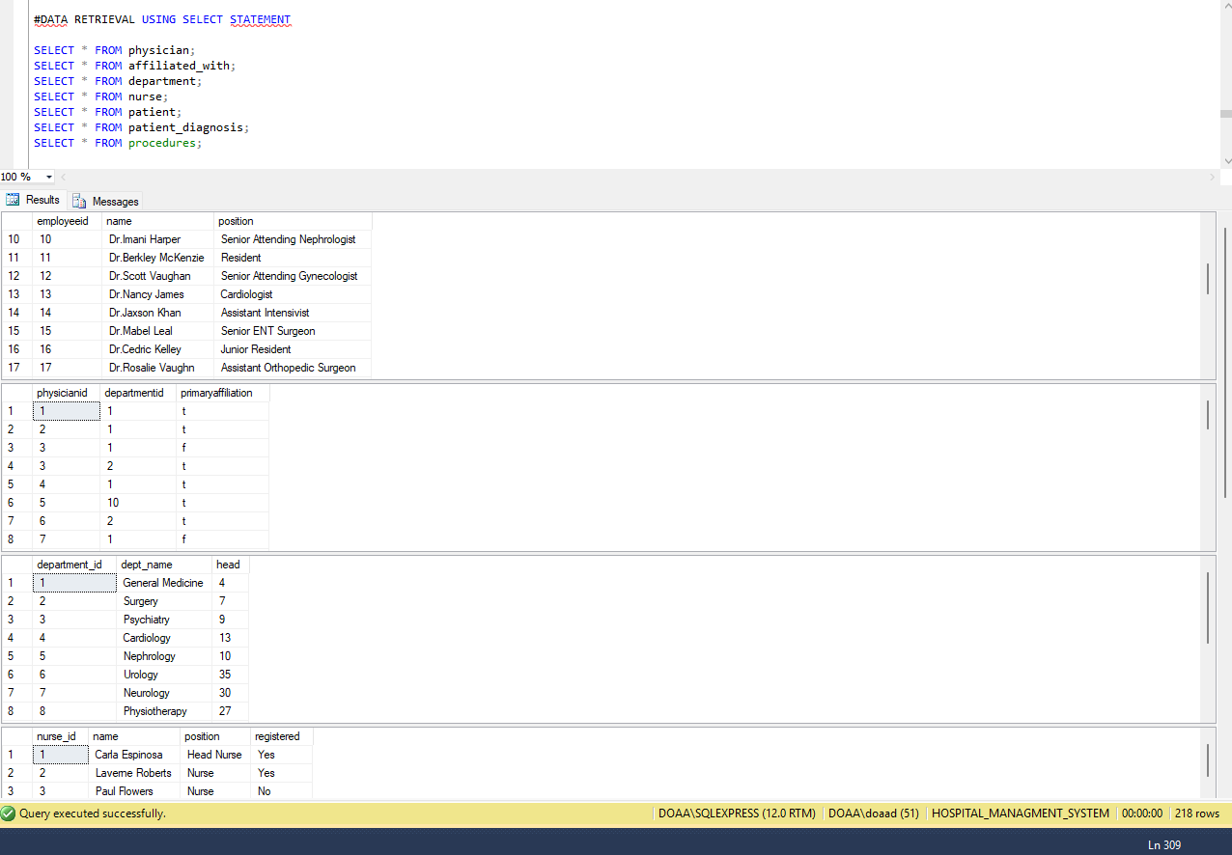
OUR DATA THAT CONVERTED TO DATAFRAME

Slide 7
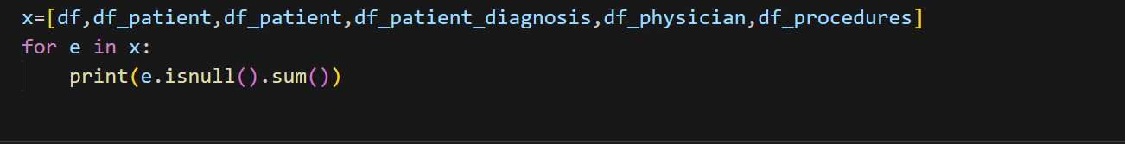
Check for null

Slide 8

Describe our dataframes

Slide 9
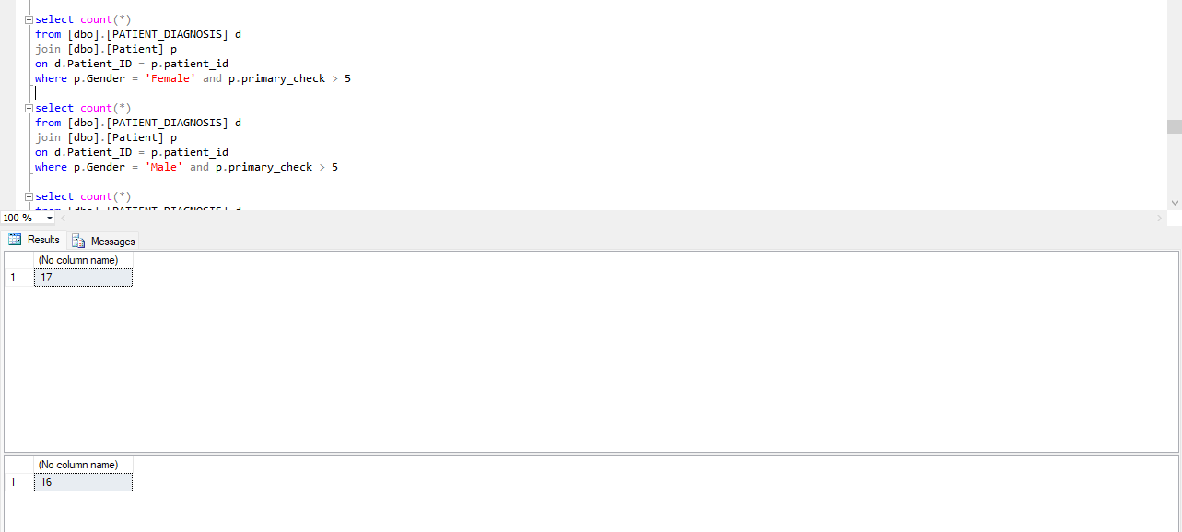
QUERY TO COMPARE BETWEEN MALES AND FEMALES IN PRIMARY CHECK

Slide 10
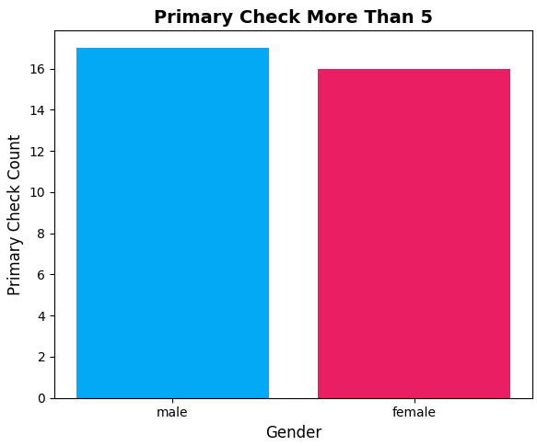

Slide 11
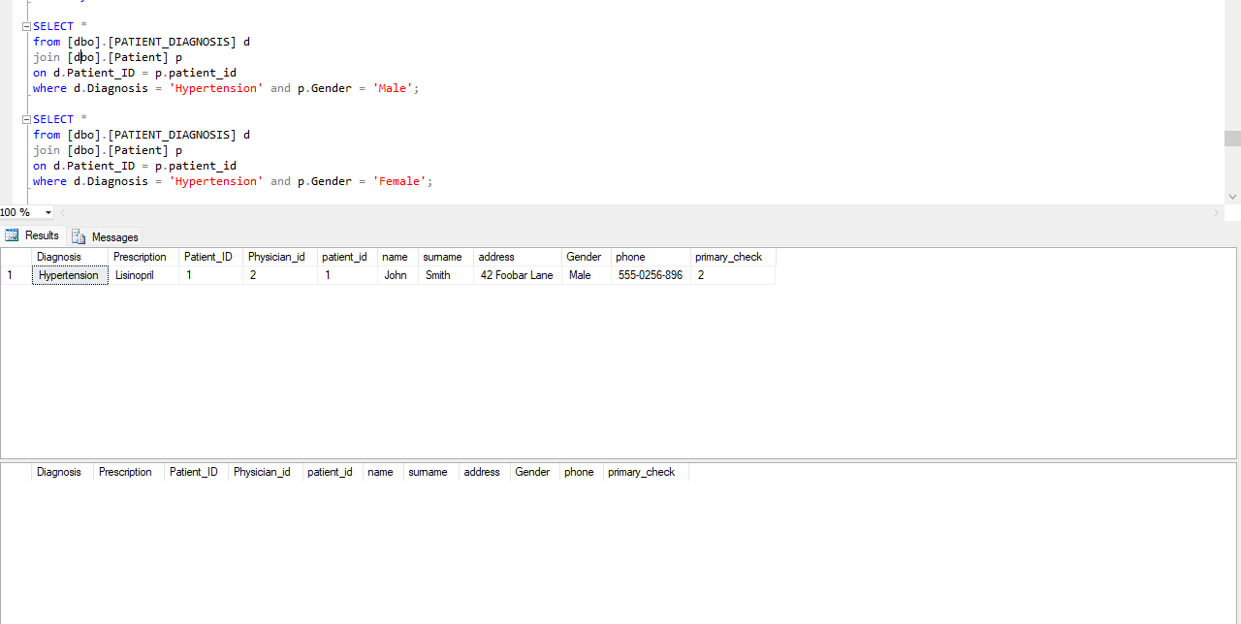
QYERY TO EXPLORE hypertension IN MALS AND FEMALES

Slide 12
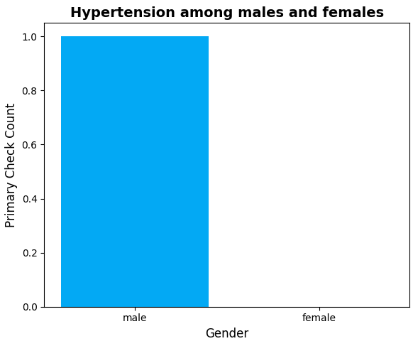

Slide 13
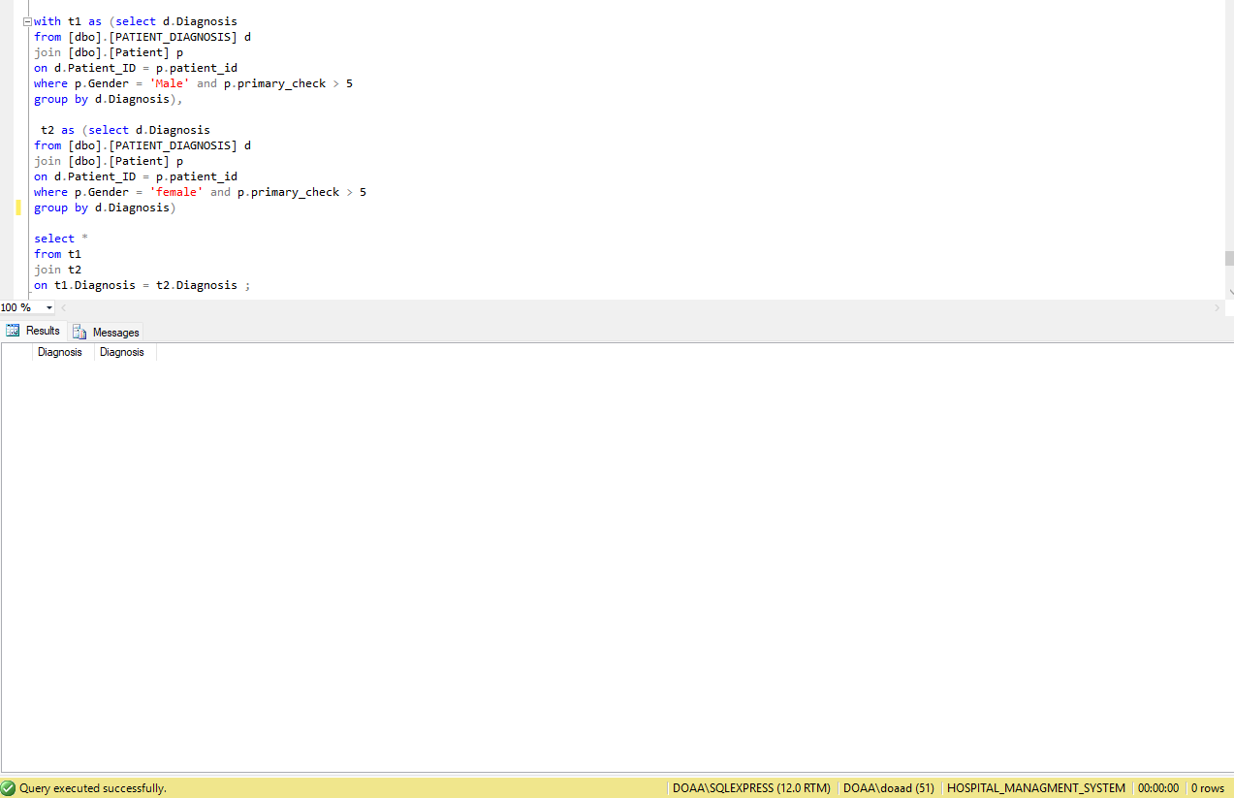
QUERY TO EXPLORE SHARED DISEASES

Slide 14
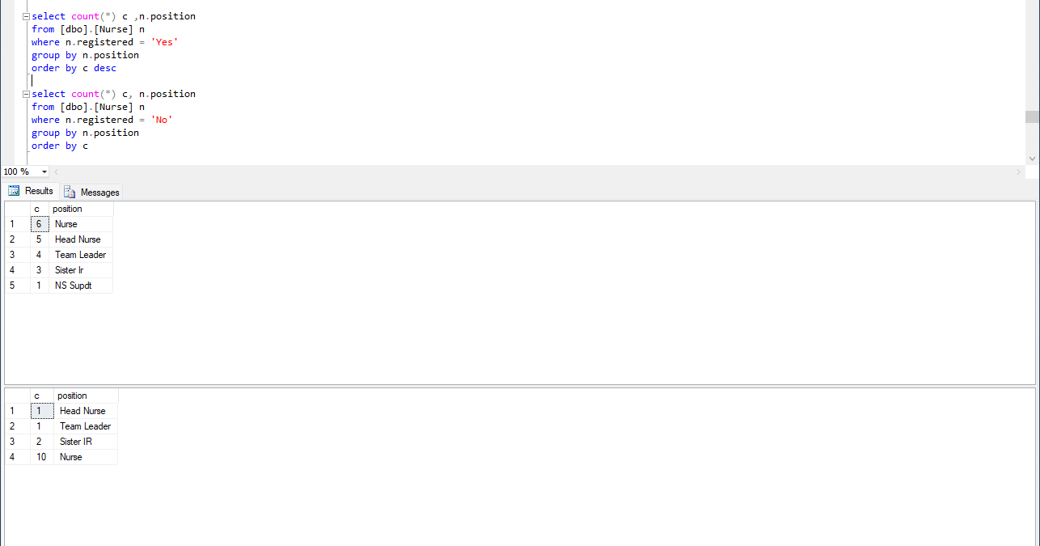
QUERY TO compare the primary check registration among positions

Slide 15
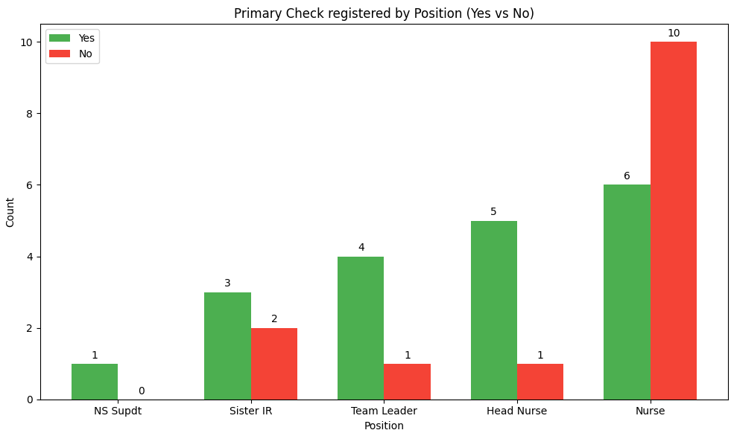

Slide 16
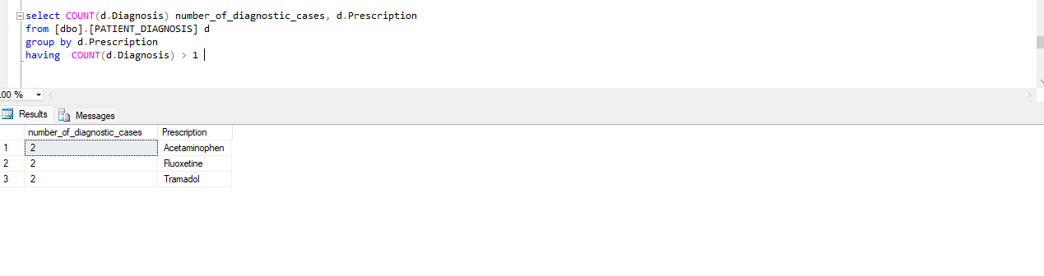
QUERY TO EXPLORE DRUGS USED IN MULTIPLE CONDITIONS

Slide 17
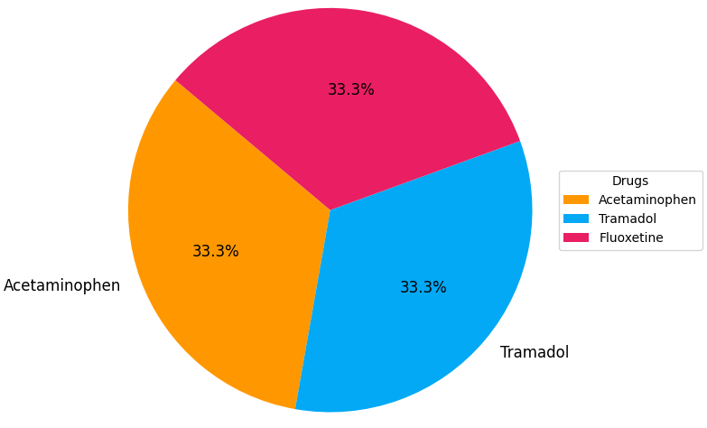

Slide 18
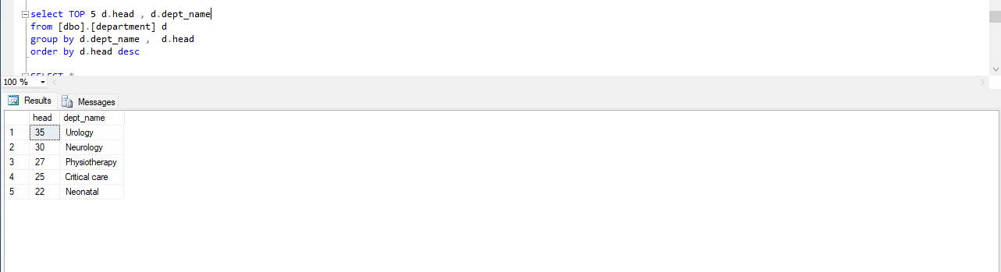
QUERY TO EXPLORE positions occupied by more than one physician

Slide 19
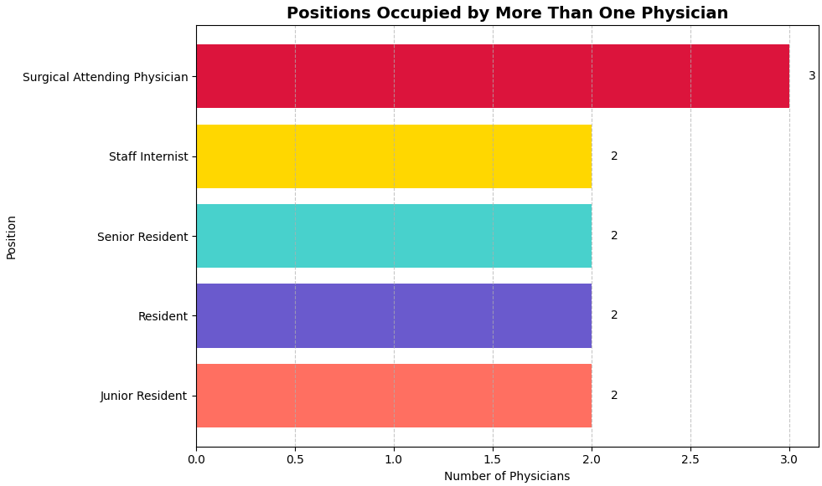

Slide 20
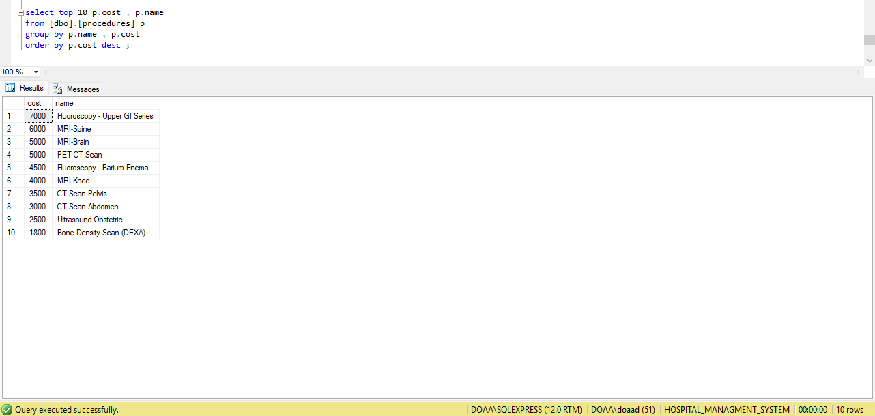
QUERY TO FIND top 10 most expensive medical procedures

Slide 21
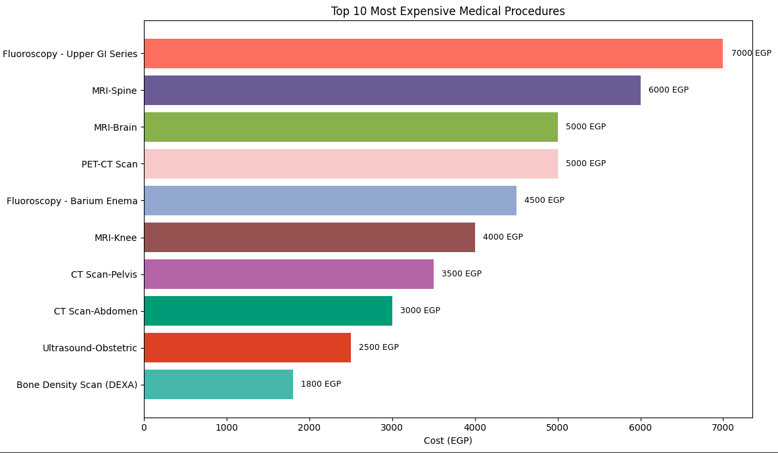

Slide 22

OUR INSIGHTS
Hypertention is more common in males
Males berform primary check more than 5 times more common than females
No common diseases shared between males and females
Tramadole , Acetraminofine and Fluexitine are the drugs that used in more than one condition
The highest primary check registration are found among nurses
Surgical attending physician is the highest position that occupy by more than onedoctor
Fluoroscopy - upper gi series is the most expensive medical procedure

Slide 23
Thank you

